Slide 1
Using Social Media For Your Rotary Club

Slide 2
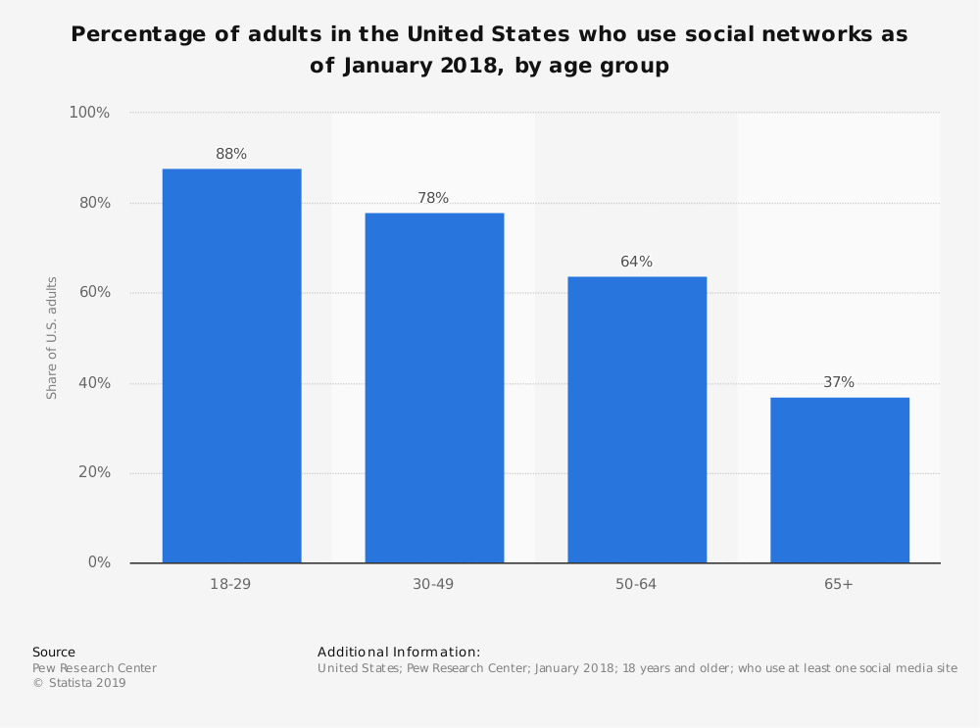
Update on U.S. Social Media Landscape

Slide 3
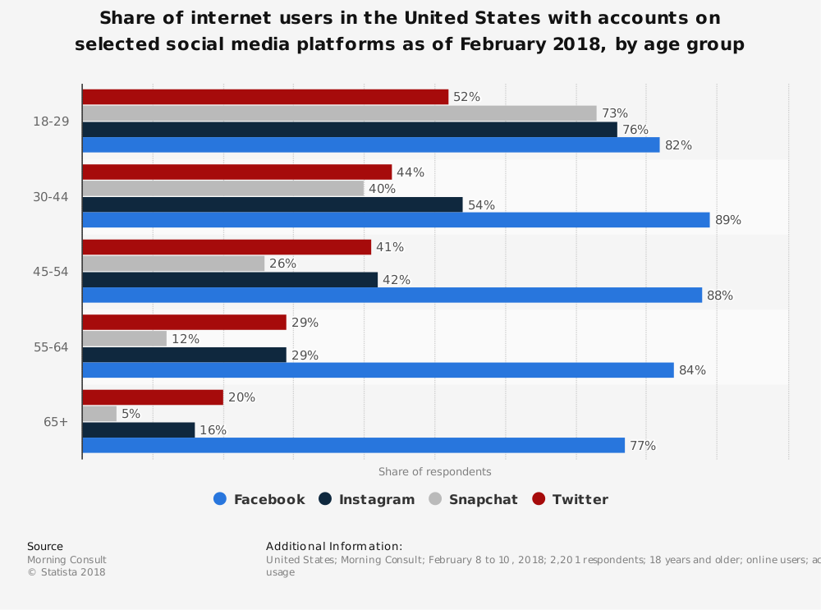
Update on U.S. Social Media Landscape

Slide 4
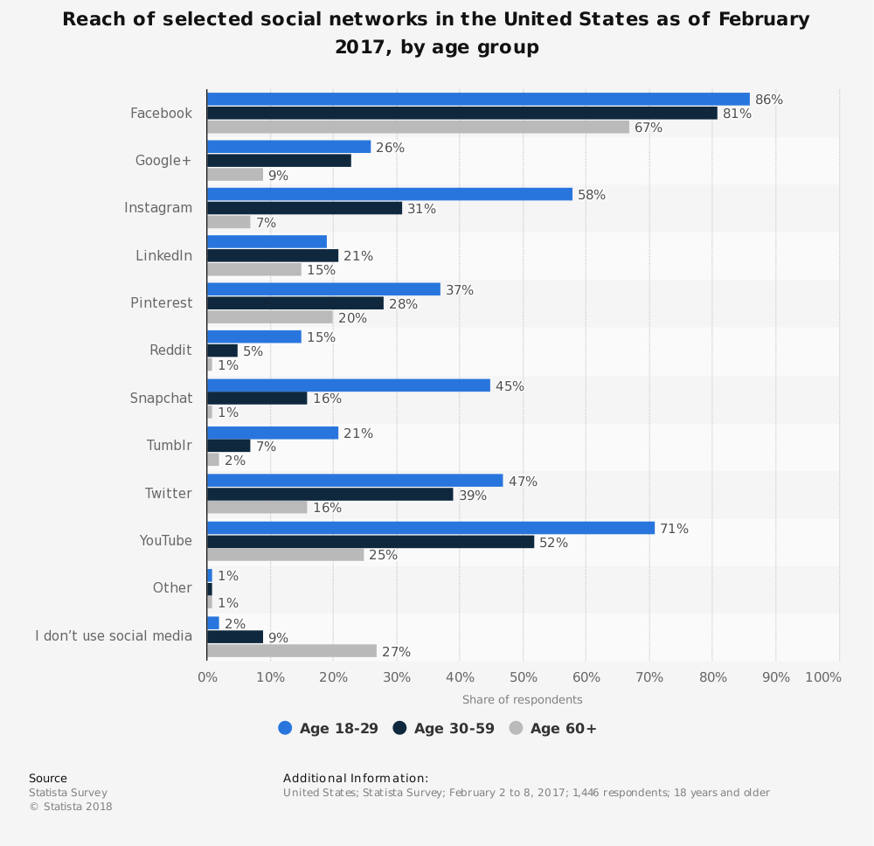
Update on U.S. Social Media Landscape

Slide 5
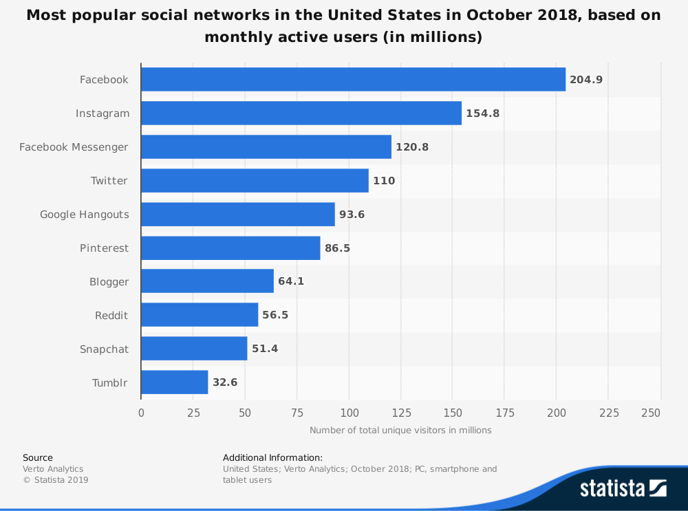
Update on U.S. Social Media Landscape

Slide 6
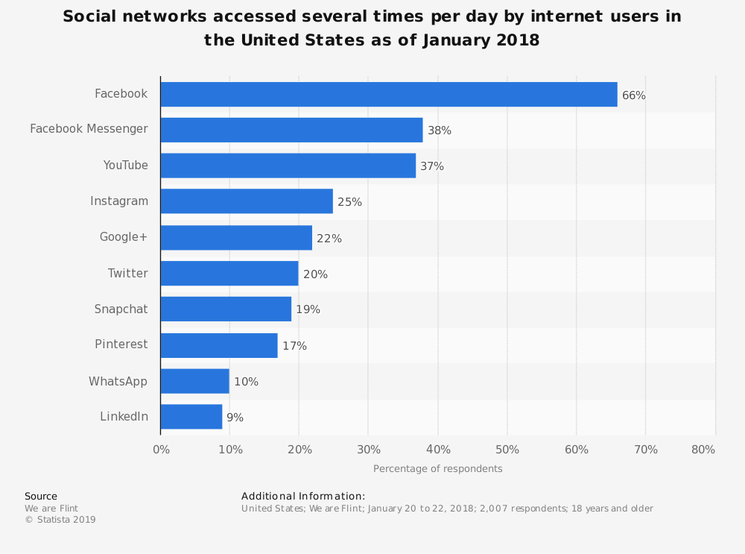
Update on U.S. Social Media Landscape

Slide 7
Update on U.S. Social Media Landscape
Takeaways:
Facebook still top priority
Add Instagram & YouTube to your arsenal
Twitter more important than you think
  Media are heavy users…monitor for story ideas

Slide 8
What can you do with Social Media?
Educate the public about what Rotary is and does
Express your friendship toward your members and others in your community
Promote your meetings and speakers
Promote your events and service projects
Raise money

Slide 9
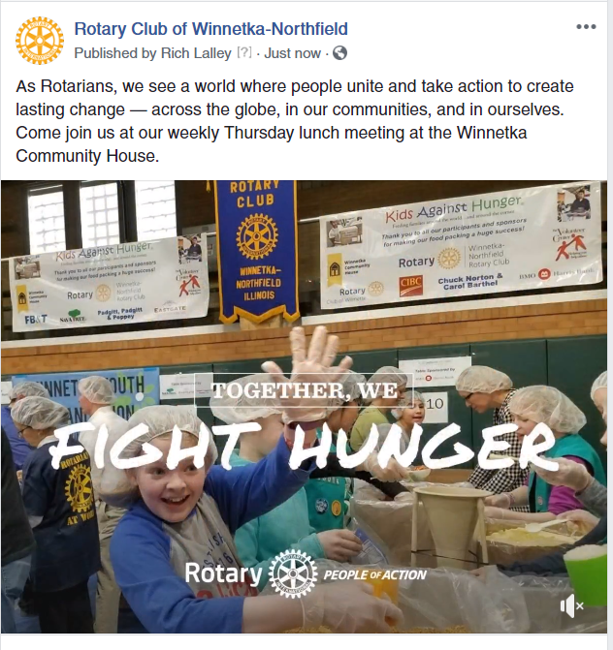
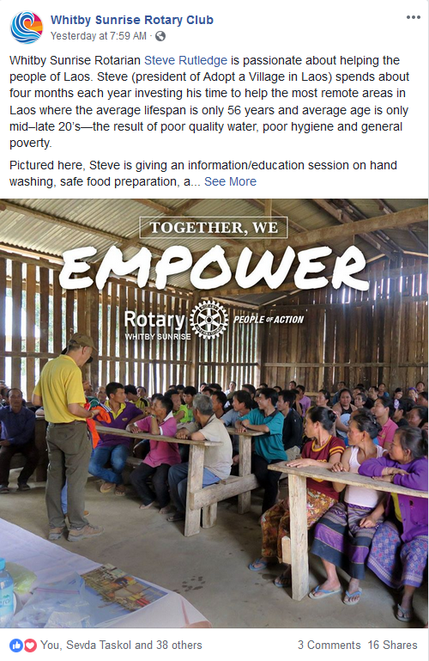
Educate the Public about Rotary and your Club

Slide 10
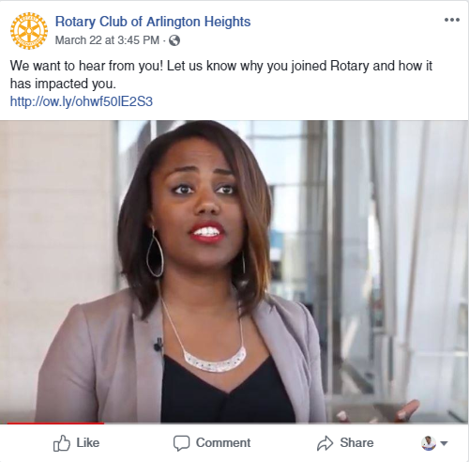
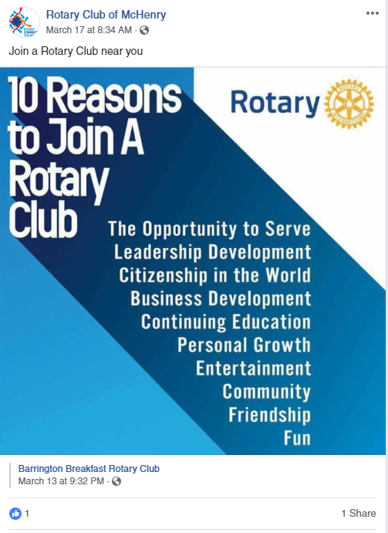
Educate the Public about Rotary and your Club

Slide 11
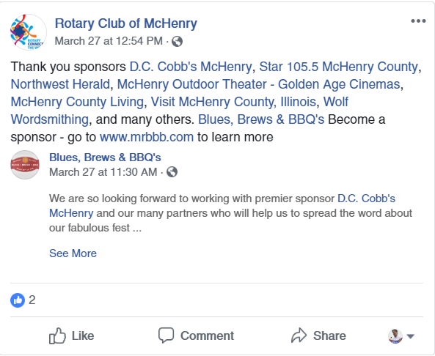
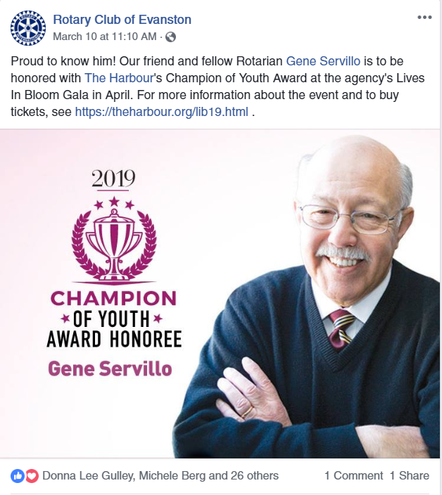
Express your friendship toward your members and others in your community

Slide 12
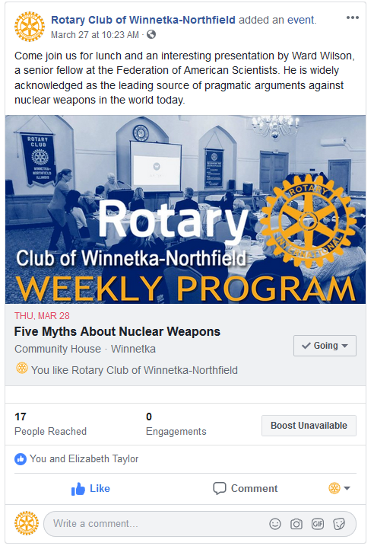
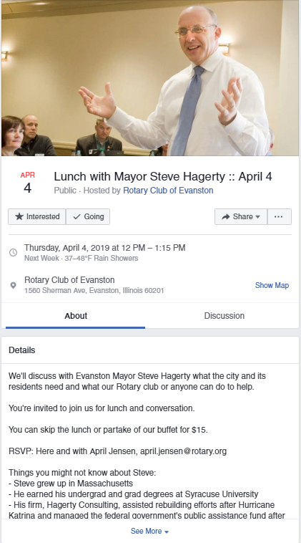
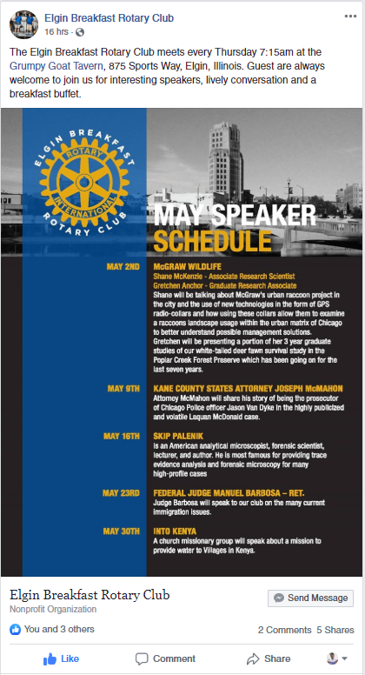
Promote Your Meetings and Speakers

Slide 13
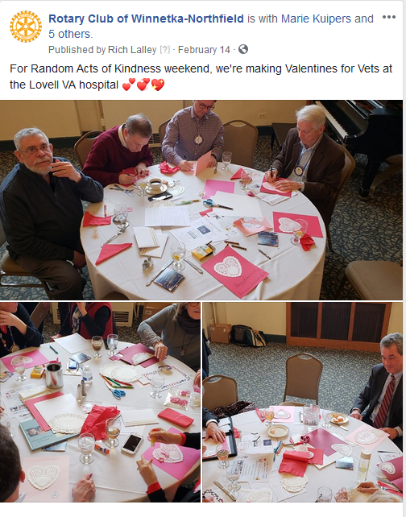
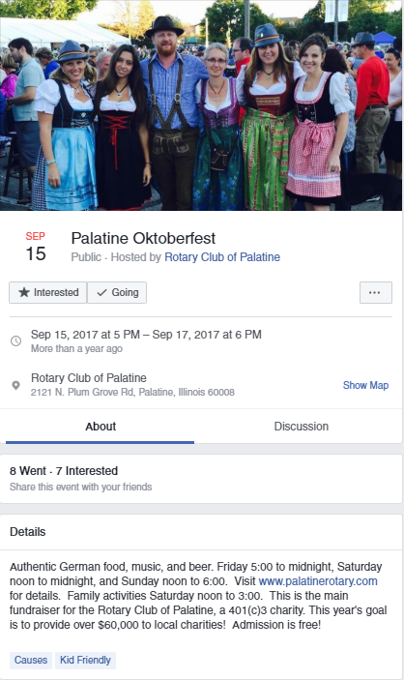
Promote your events and service projects

Slide 14
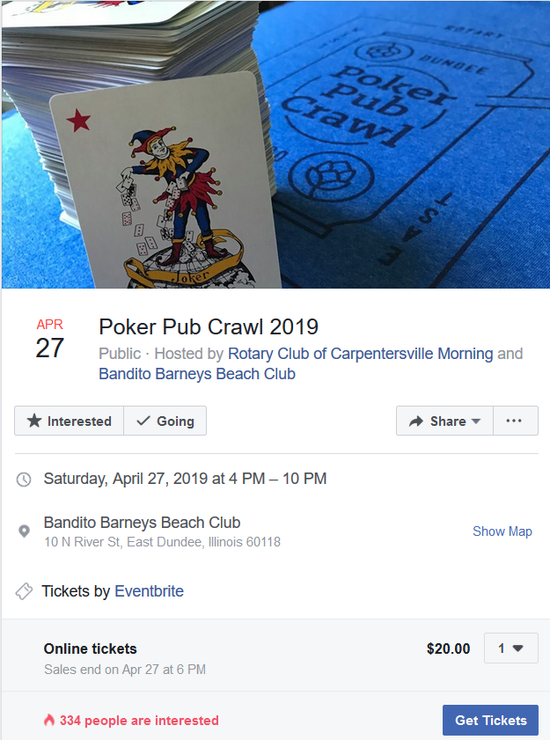
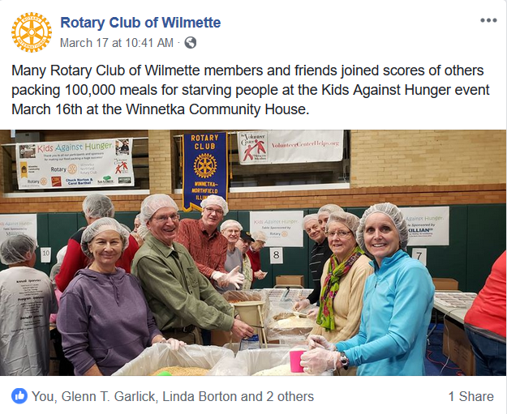
Promote your events and service projects

Slide 15
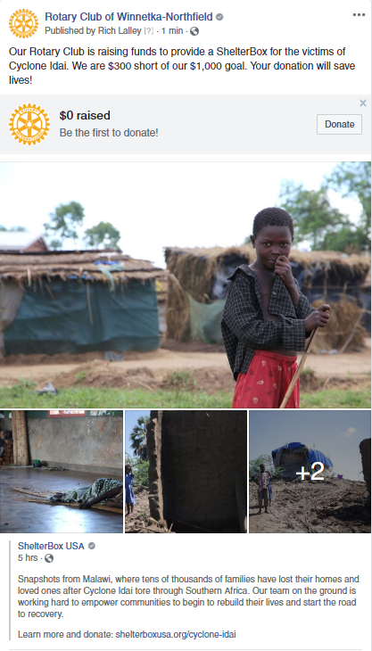
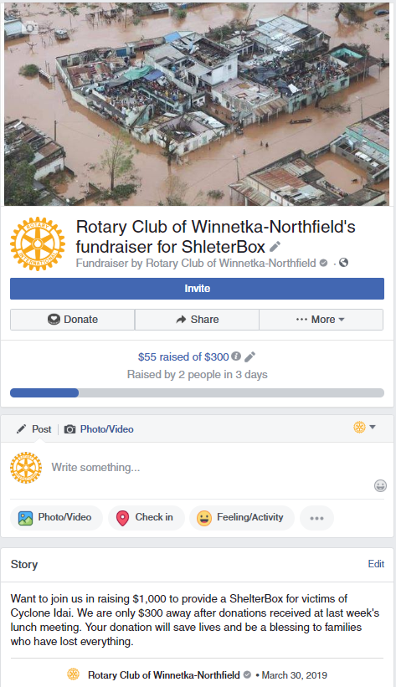
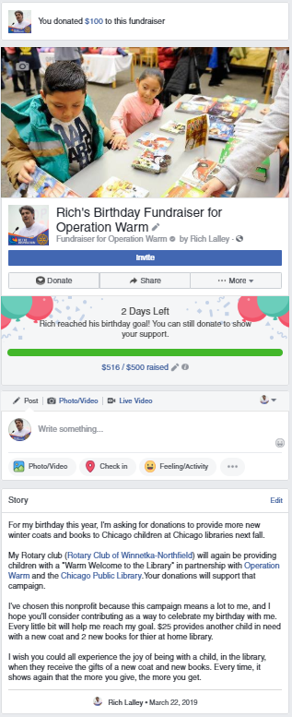
Raise money

Slide 16
There are No Free Lunches or
Free Advertising

Slide 17
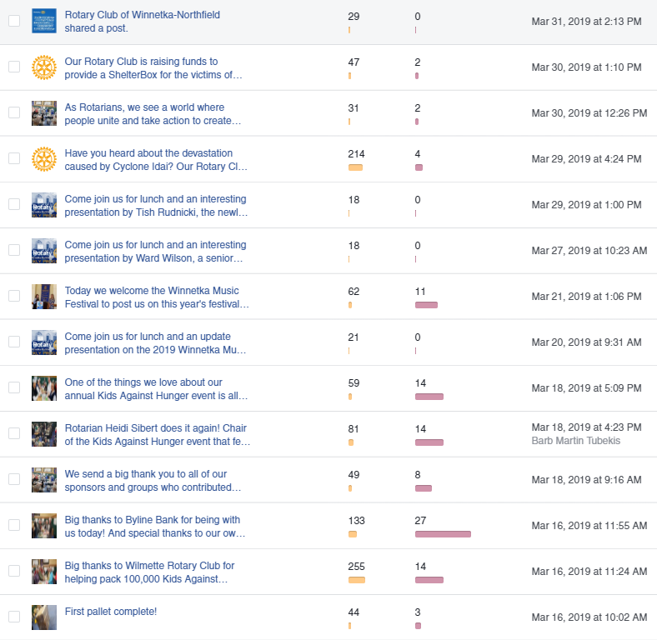
Reaching the Public is No Longer Free

Slide 18
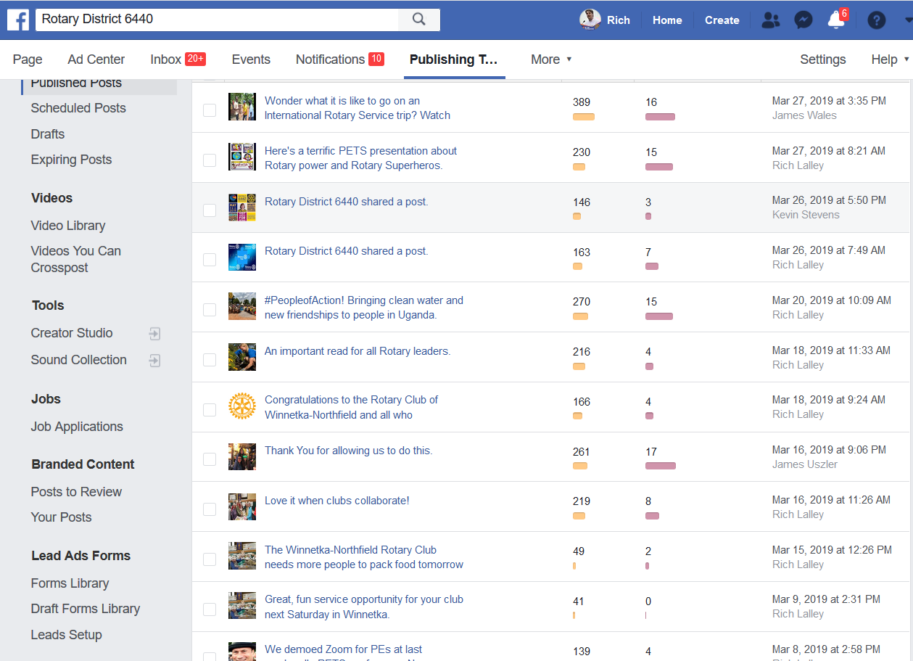
Reaching the Public is No Longer Free

Slide 19
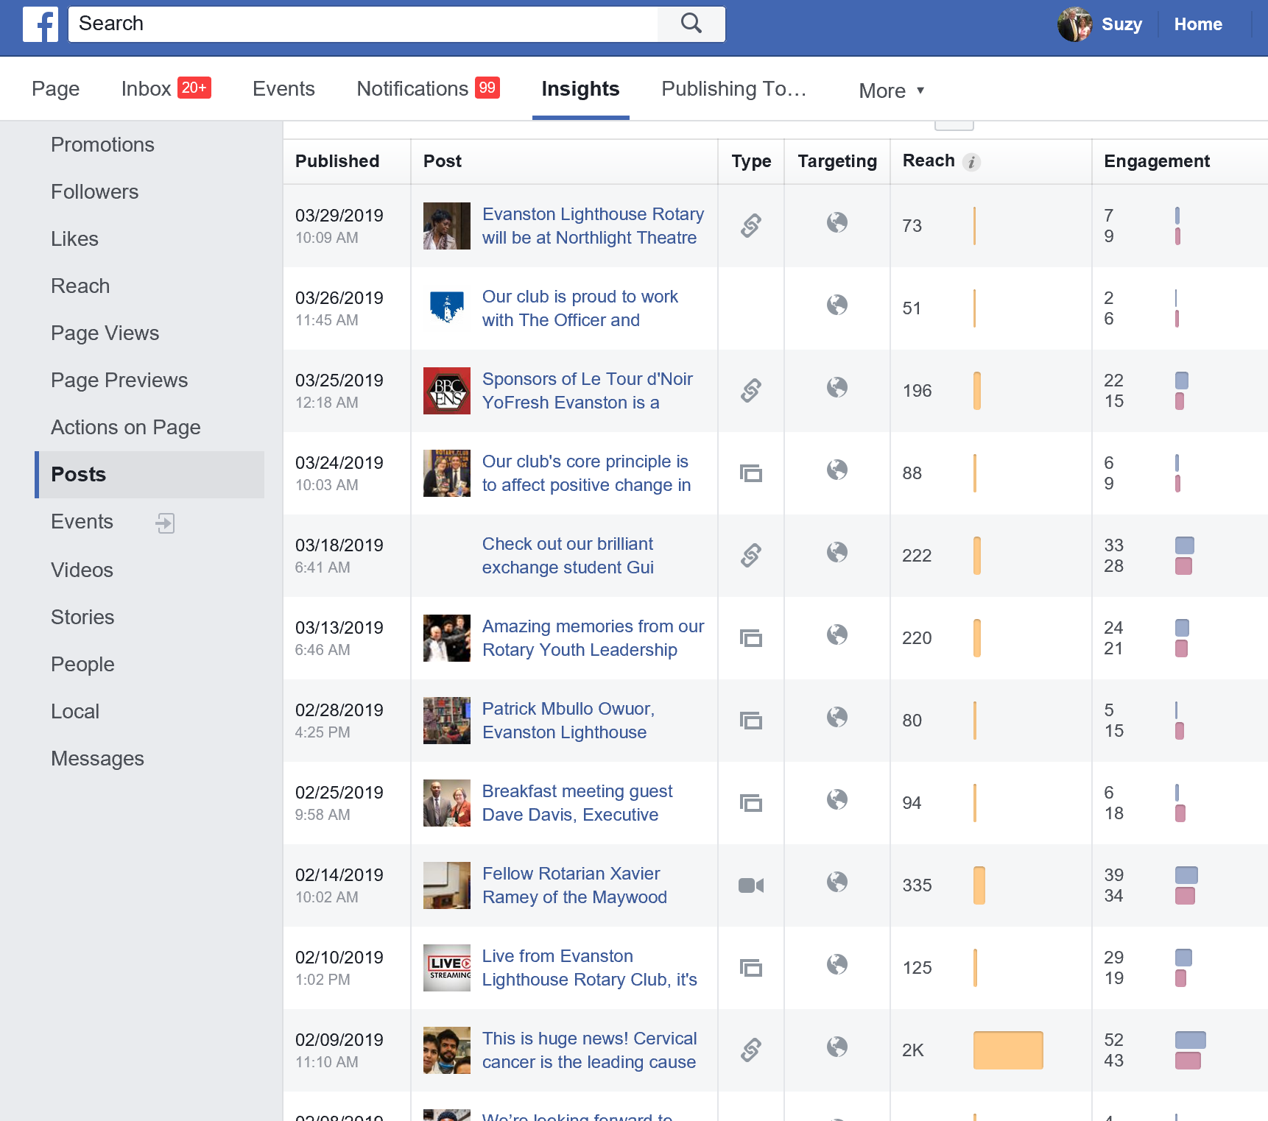
Reaching the Public is No Longer Free

Slide 20
How Much Does Advertising Cost?
It Depends!
  What season it is
  What day of the week it is
  What time of day it is
  How many users you’re targeting and who they are
  What locations you’re targeting
  What demographics you’re targeting
  How relevant your ad is to your target audience
  Overall quality of your ad
  What industry you’re in

Slide 21
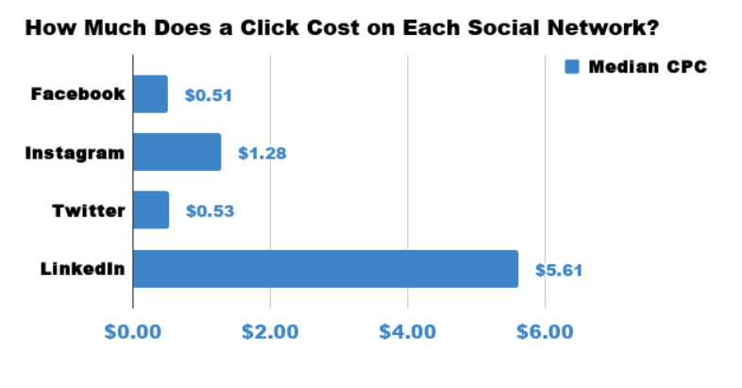
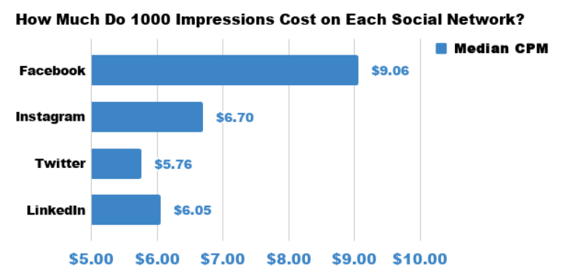
How Much Does Advertising Cost?
Two Standard Cost Metrics
Cost per Click (or other action)
Cost per Thousand Impressions (CPM)
https://www.falcon.io/insights-hub/topics/social-media-roi/how-much-do-ads-cost-on-facebook-instagram-twitter-and-linkedin-in-2018/

Slide 22
Advertising Education Resources
Ask Google!
  https://www.causevox.com/nonprofit-facebook-ads/
  https://www.facebook.com/business/success/categories/non-profits-organizations
  https://www.facebook.com/fundraisers/
  https://www.wordstream.com/blog/ws/2018/06/18/facebook-ads-for-nonprofits

Slide 23

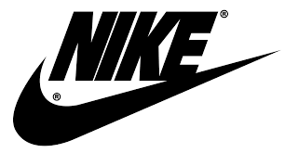




Please Use Contemporary Rotary Branding!
Rotary Should Be a Great Brand Too!

Slide 24
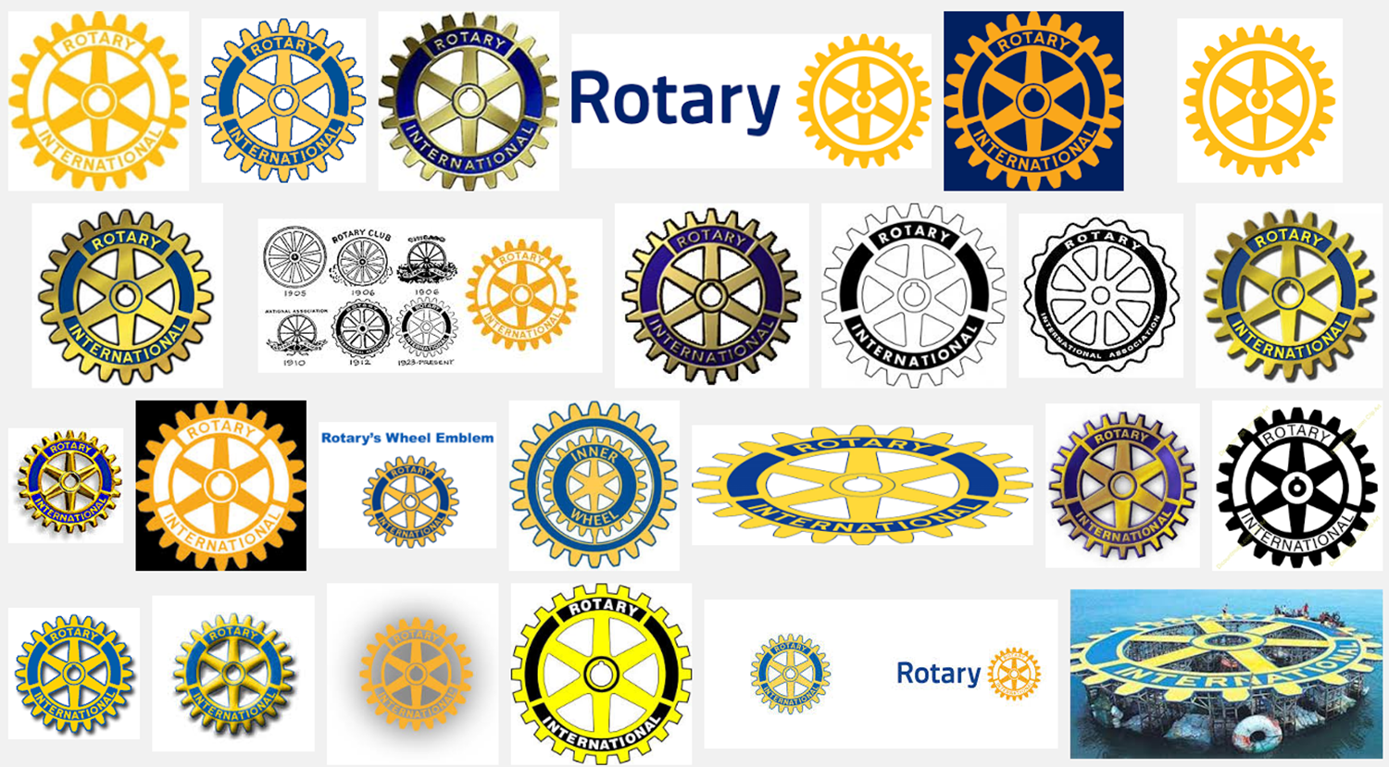
Rotary Historically

Slide 25













Rotary At the Club Level

Slide 26


Today’s Rotary Brand
“Masterbrand Signature”
“Mark of Excellence”

Slide 27
Great Brands

Slide 28
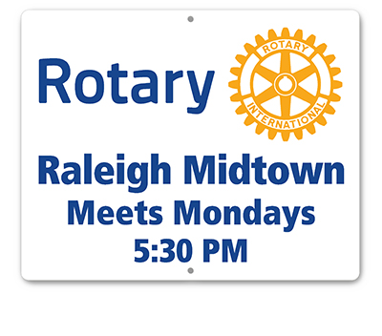




Rotary at the Club Level

Slide 29










Synergy Across Programs and Platforms

Slide 30

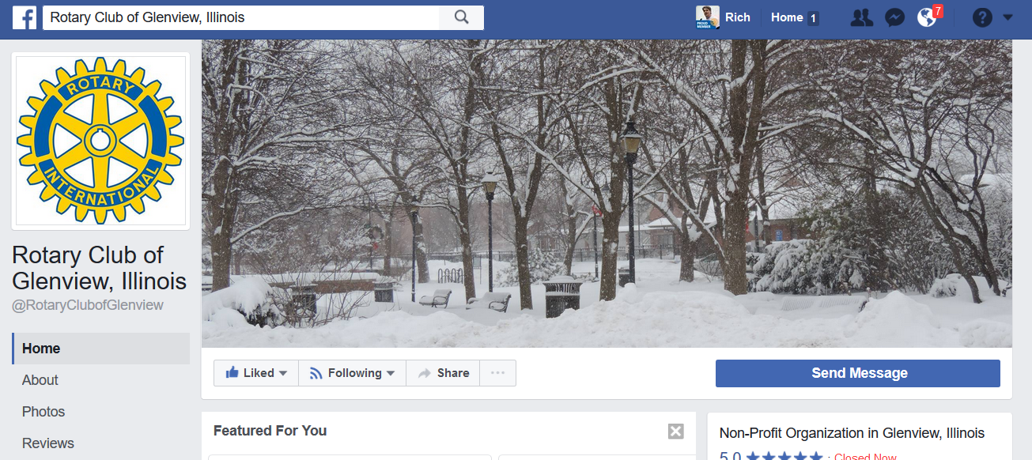
ACTION PLAN
What club logo(s) do you use?
  Website
  Social Media
  Signage
  Invitations
  Letterhead and
  business cards?
  Anywhere else?

Slide 31
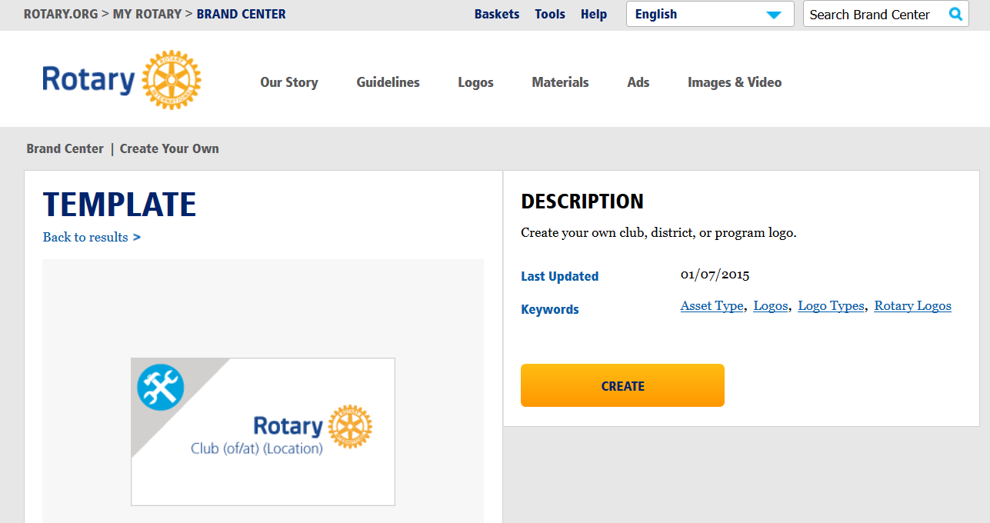
ACTION PLAN
Update to current graphic standards
Rotary Brand Center- Logo Creating Tool

Slide 32



ACTION PLAN
Pro Tip: Use PNG file type for transparent background

