Slide 1
FUNDRAISING ON FACEBOOK FOR ROTARY CLUBS- A PRACTICAL PRIMER
Rich Lalley, Zone 28 Assistant Rotary Public Image Coordinator
District 6440 Technology and Communications Coordinator
Rotary Club of Winnetka-Northfield

Slide 2
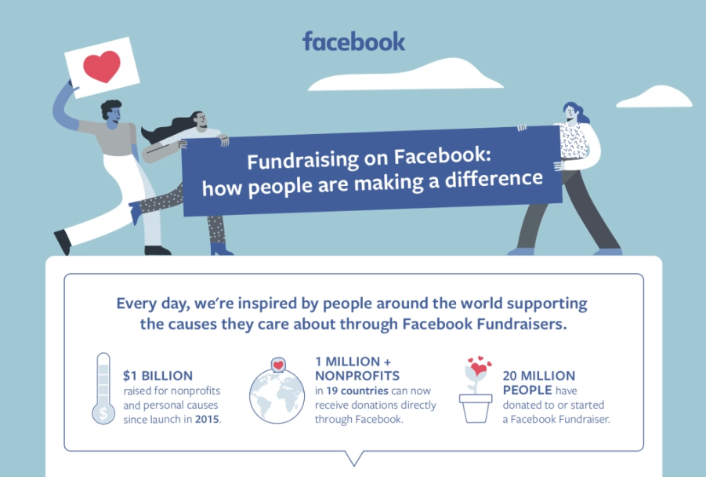

Slide 3
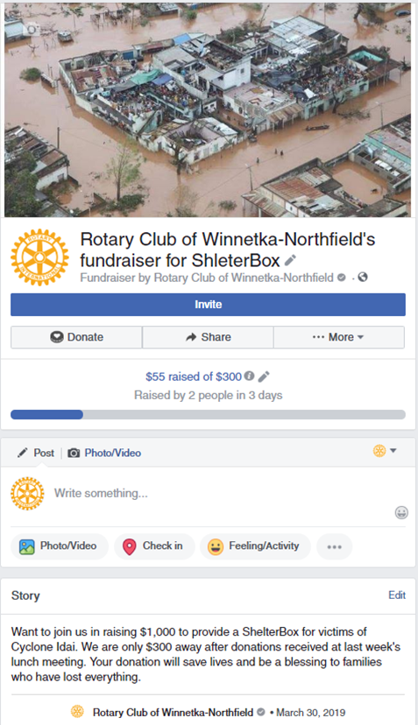
Fundraising on Facebook is rapidly growing
  $125 million raised on Giving Tuesday by Facebook users, up from $45 million prior year.
  1 million nonprofits in 19 countries can receive donations directly through Facebook.
  Over 20 million people have either donated to or started a fundraiser on Facebook.

Slide 4
Who can raise funds on Facebook, and for what?
Anyone with a Facebook account
For any cause
  No fees if supporting a charity registered with Facebook
  Facebook takes 2.60% + $0.30 USD per donation for personal fundraisers and for non-registered organizations

Slide 5
How can my club raise money on Facebook?
501(c)(3) with bank account?
Facebook Page?
Category is 'Nonprofit Organization’ or 'Charity Organization' and official address is included in the ‘About’ section.
Sign up for Facebook Payments from a Page admin account.

Slide 6
What’s needed to apply?
Last 3 months bank statements
Name and date of birth of CEO or Executive Director.
Tax ID number (EIN) which will verify charitable tax exemption status.
The application must be completed in full and progress cannot be saved.
www.facebook.com/donate/signup

Slide 7
Fundraising Tools- Donate Button

Slide 8
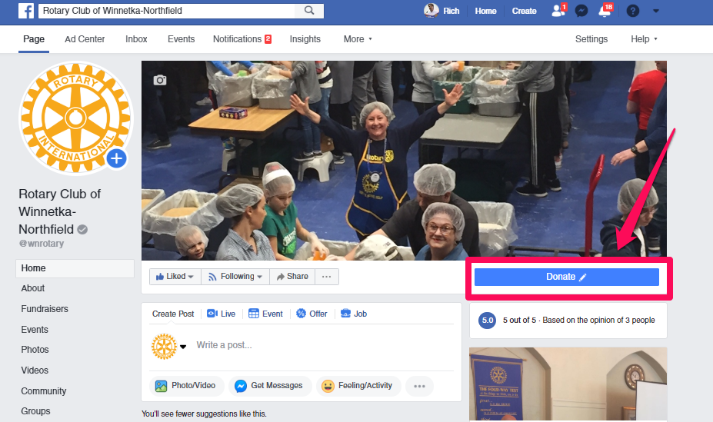
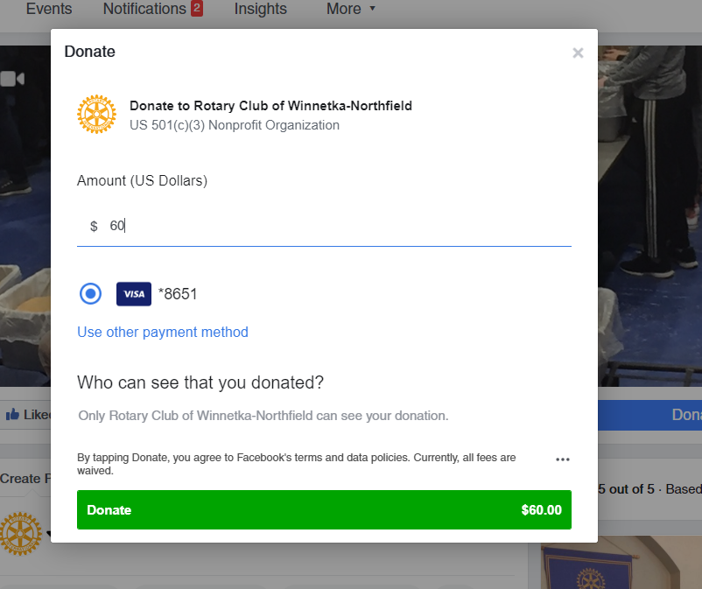

Slide 9
Fundraising Tools- Page Fundraisers

Slide 10
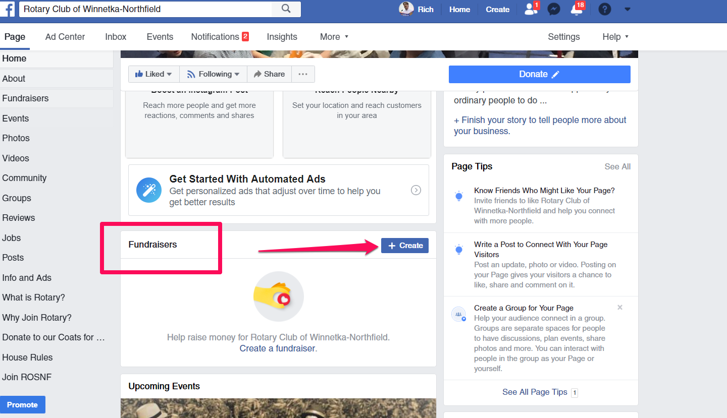

Slide 11
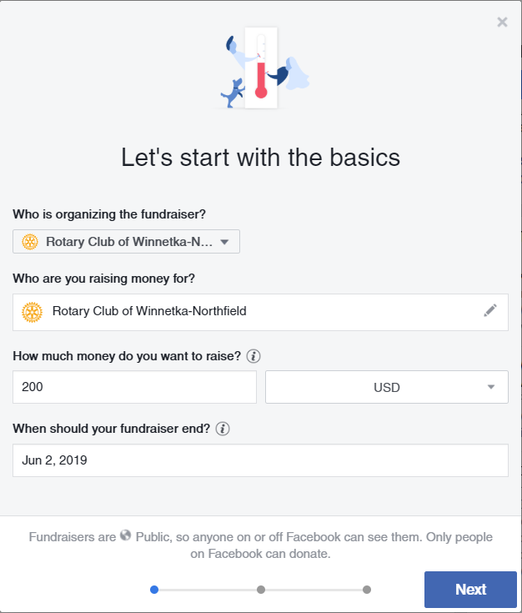
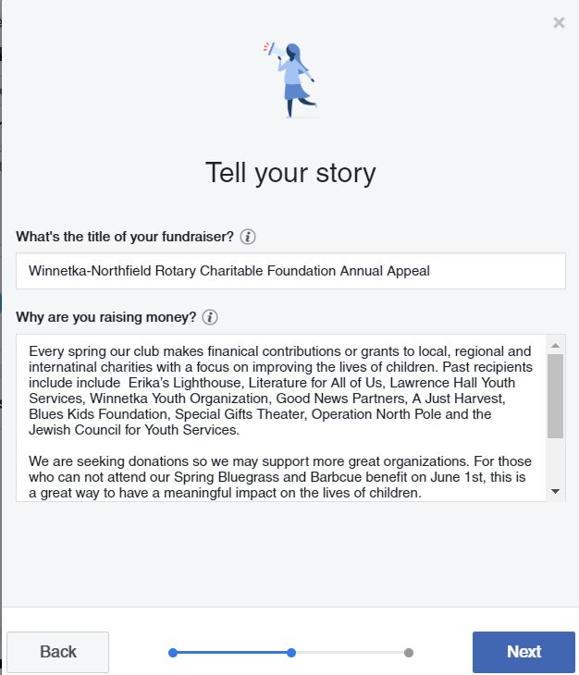
Title is use on FB posts and in donation reports

Slide 12
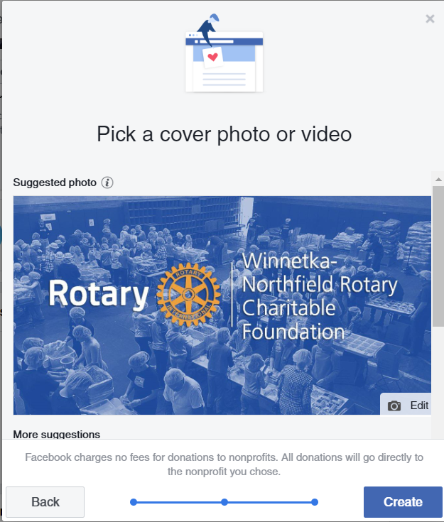
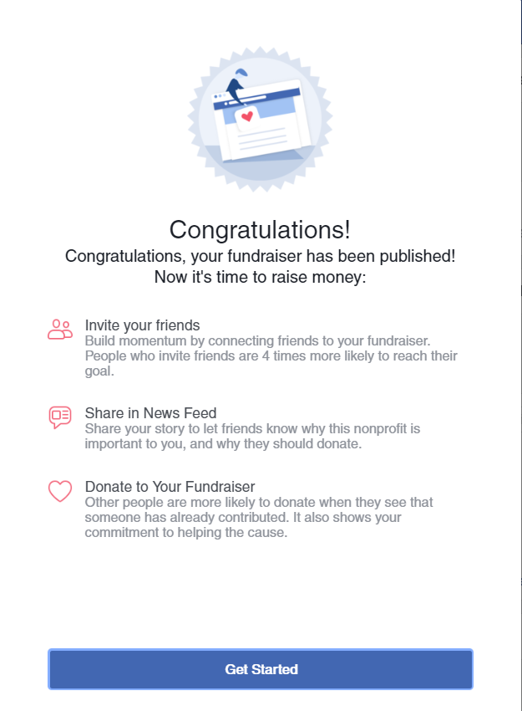

Slide 13
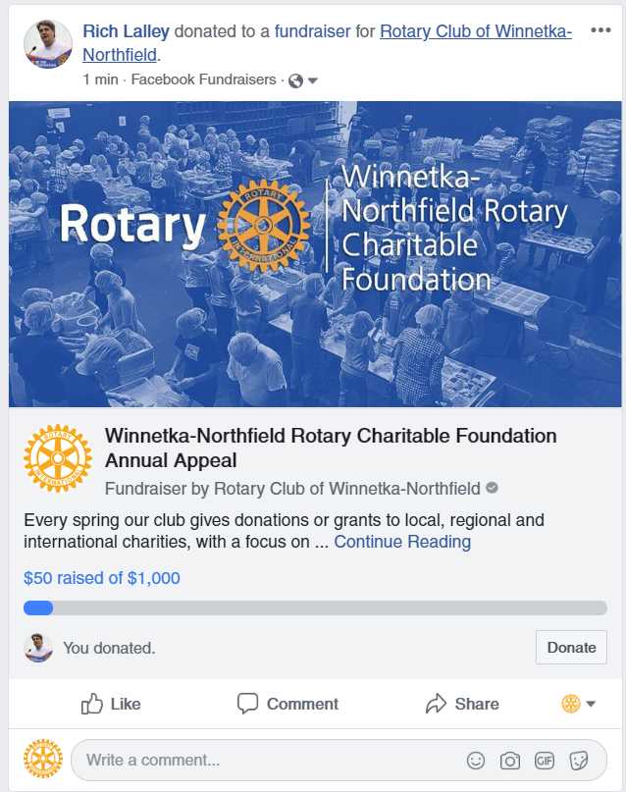

Slide 14
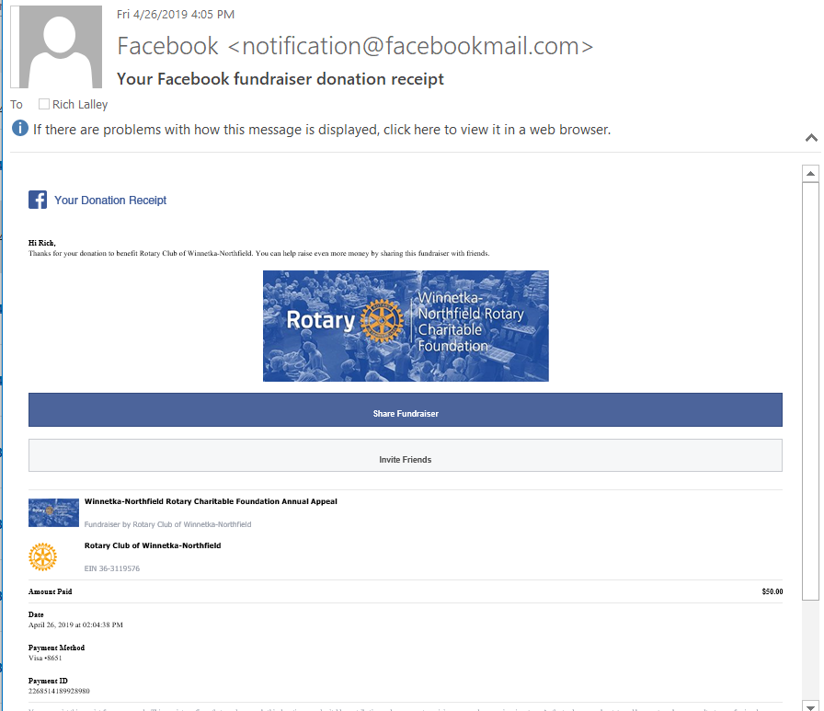
Donation receipt emailed from Facebook.
Donor emails will typically not be reported to charity. Depends on donor privacy settings.

Slide 15
Personal Fundraisers

Slide 16
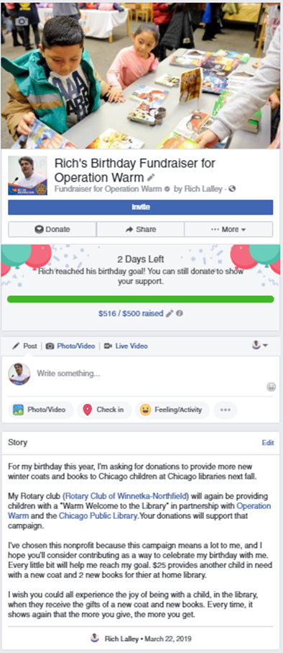
Birthday
Anytime
Choose any charity or cause

Slide 17
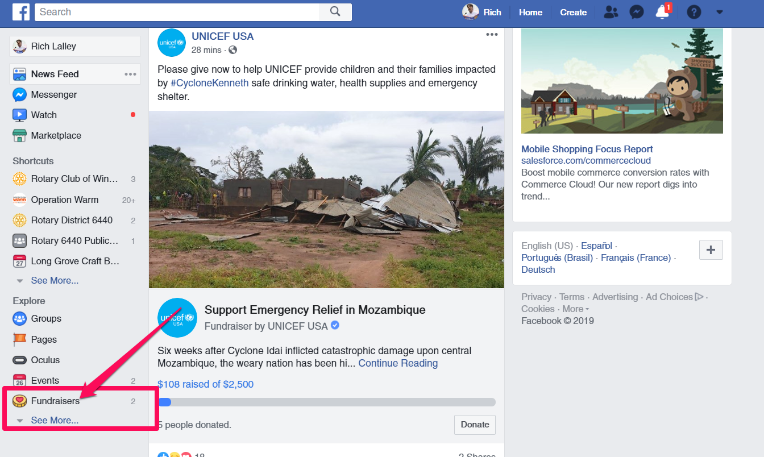

Slide 18
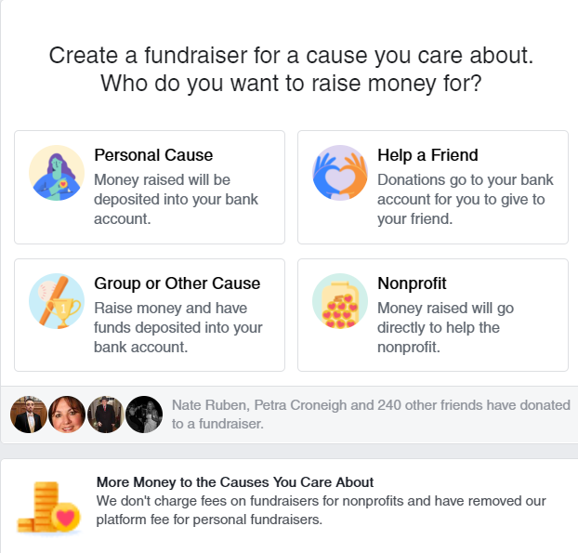

Slide 19
How does money get dispersed?
Facebooks pays out twice per month, approximately 30 days after funds are raised.
Minimum $100 per payout (not fundraiser).
Reports of donations by day, donations in a date range, and payouts transferred to bank accounts.
  On Page as Admin, Settings > Donations

Slide 20
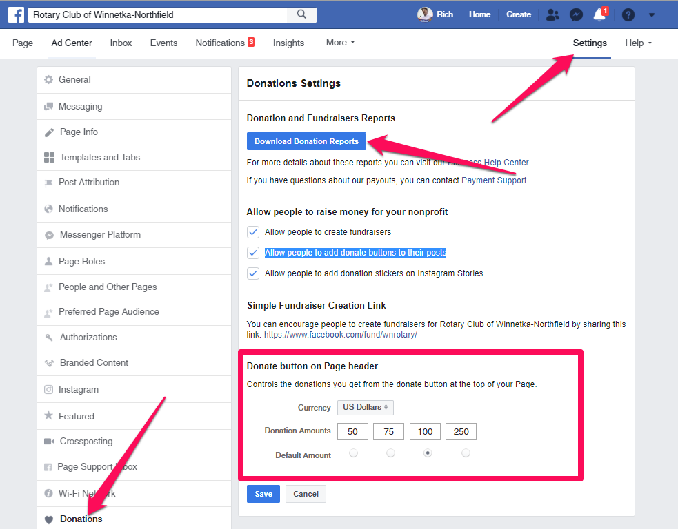

Slide 21
Keys to Fundraising Success
Asks that are timely, specific, and compelling.
  Position the donor as the hero.
  Easy to read. 5th grade reading level
  (Hemingway App).
Visuals — ideally an eye-catching, emotional video — to tell a story and inspire action.
An incredibly easy-to-use fundraising platform.
An easy way for donors to ask their peers for donations.

Slide 22
Keys to Fundraising Success
Make the first donation- no one wants to donate to a cause with no support.
Invite many people to support the fundraiser.
Share the fundraiser. Get your members to share it!
Thank your donors.
Thank them again!
Report back on how the funds were used and the impact they made.
Ask again.

Slide 23
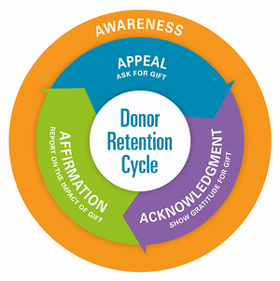

Slide 24
Keys to Fundraising Success
The donor is the hero. Not you or your charity.
Ask often! Don’t make the number 1 mistake of most fundraisers.
Test paid advertising.
  Define your target- age, interests, location
Can you get a matching gift donor?
Don’t forget snail mail- it still works, especially with senior citizens (who donate the most!).

Slide 25
A Request:
Please Use Contemporary Rotary Branding!

Slide 26






Great Brands- Rotary Should be One Too!

Slide 27

Rotary Historically

Slide 28













Rotary At the Club Level

Slide 29


Today’s Rotary Brand
“Masterbrand Signature”
“Mark of Excellence”

Slide 30
Great Brands

Slide 31





Rotary at the Club Level

Slide 32










Synergy Across Programs and Platforms

Slide 33

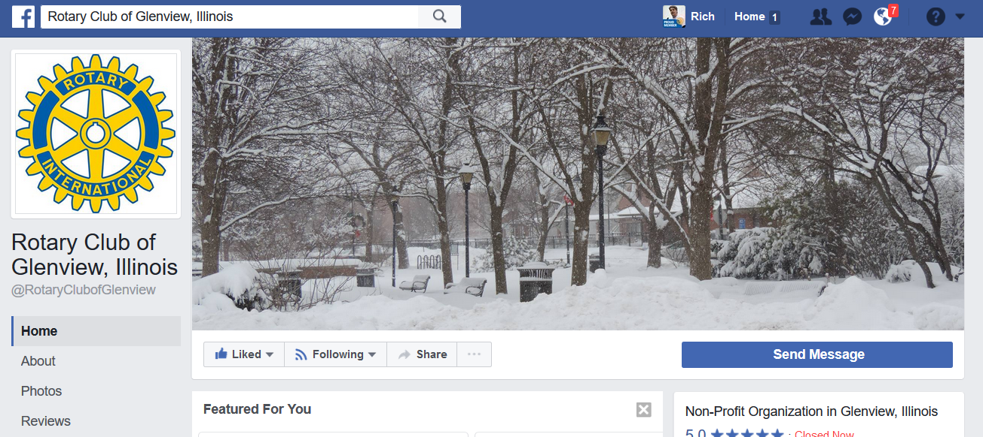
ACTION PLAN #1
What club logo(s) do you use?
  Website
  Social Media
  Signage
  Invitations
  Letterhead and
  business cards?
  Anywhere else?

Slide 34
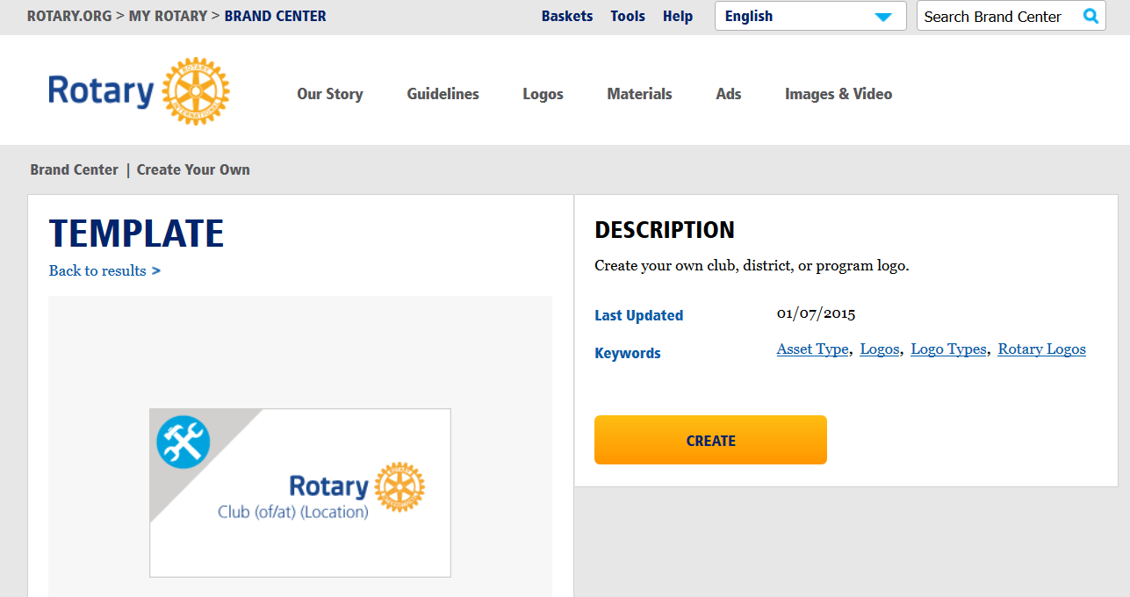
ACTION PLAN #1
Update to current graphic standards
Rotary Brand Center- Logo Creating Tool

Slide 35



Action Plan #1
Pro Tip: Use PNG file type for transparent background

Slide 36
Questions?

